Slide 1
Building Large, Yet Maintainable, ASP.NET Applications
Scott Sauber

Slide 2
Who am I
Lead Software Developer at Iowa Bankers Association
Work in Mortgage and Insurance Industry
We’re not Facebook, Stack Overflow, etc.
Highly Regulated
Lots of validation
Lots of changes
Twitter: @scottsauber
Blog (primarily ASP.NET Core): scottsauber.com

Slide 3
Audience
Existing ASP.NET Developers
Building “Large” applications
Large to me, means a combination of these:
Many Views
Many Controllers
Lots of business logic
High business impact
Frequent Change
Large != High Traffic
Some of these recommendations only make sense for big apps that change frequently
Introduce some minor complexity, but improves overall maintainability
That trade off is only worth it in large apps that change a lot

Slide 4
Agenda
Lightning Talk approach
Talk about best practices for all these *in a “large” app*
Folder Structure
UI Components
View Models
Code Flow
Validation
ORM’s
Dependency Injection
Unit Testing and Assertions
DevOps
Microservices

Slide 5
Audience Goals
“New” perspective on a few topics
You’re not going to agree on everything
Take away some ideas to evaluate in your future workflow tomorrow

Slide 6
Overall theme
Improve Maintainability
Better practices
Consistency
Enjoyable to work with
The goal is to create systems that allow developers to make changes as easy, quick, and bug-free as possible, while allowing that trend to continue into the future.
“Legacy software is software you have no confidence in.”

Slide 7
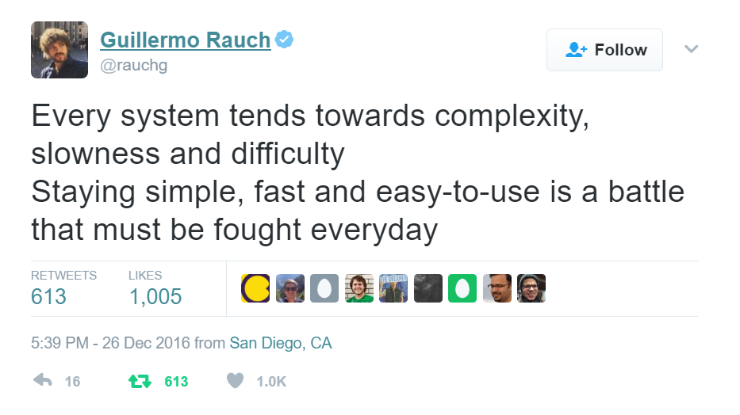

Slide 8
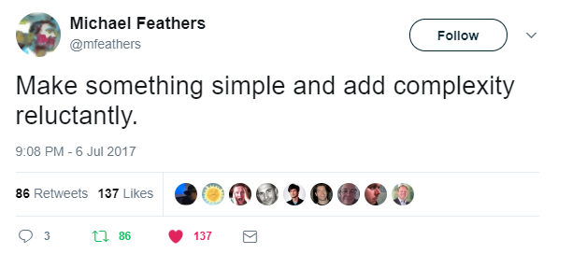

Slide 9
Folder Structure Best Practices

Slide 10
Problem: OOB MVC Folders By Responsibility
All of these live in their own separate folders and most are required to add a new feature
Controllers
Views
Scripts
Content
Models
Adds navigation friction
Scope of a feature is scattered
Makes it hard to add, delete or extend existing features

Slide 11
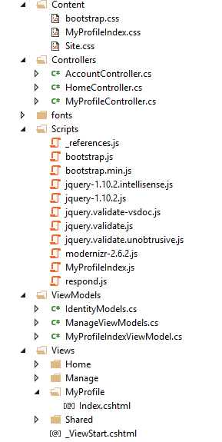
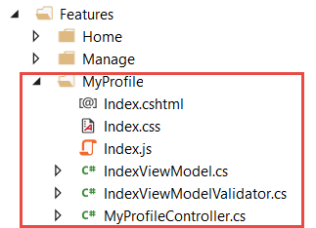
Solution: Use Feature Folders
Grouping by Feature, not by Responsibility, results in easier maintenance
Related things remain together (High Cohesion)
MVC out of the box:
Feature Folders:

Slide 12
Feature Folder Extra Resources
How to do this in ASP.NET 4.x
Tim Thomas’ blog post
How to do this in ASP.NET Core
My blog post
Steve Smith’s Blog on Feature Folders vs. Areas
Also used in React, Angular, etc.
John Papa

Slide 13
The “M” in MVC

Slide 14
Problem: ViewBag sucks and Entities = Security Risk
View Bag - Nope
Runtime errors
No intellisense
Don’t use raw Entities
Overposting AKA Mass Assignment attacks
This happens
Also just a matter of time before “I need an Entity… and 1 more thing”

Slide 15
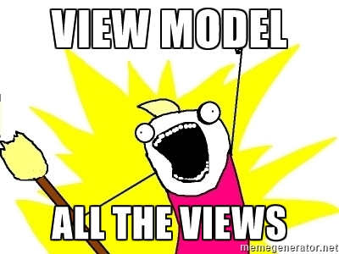
Solution: Use ViewModels
Make a View Model for all views
Consistency, no surprises
Strongly Typed

Slide 16
UI Composition

Slide 17
Make as many UI Components as you can
Benefits
SRP for the UI
Easier to reason about
Reusability
Eliminates div soup
Component architecture popularity is rising
React, Angular (2/4/whatever), AngularJS 1.5+, Knockout 3.2+
Partials
Child Actions (in ASP.NET 4/MVC 5)
View Components (in ASP.NET Core)

Slide 18
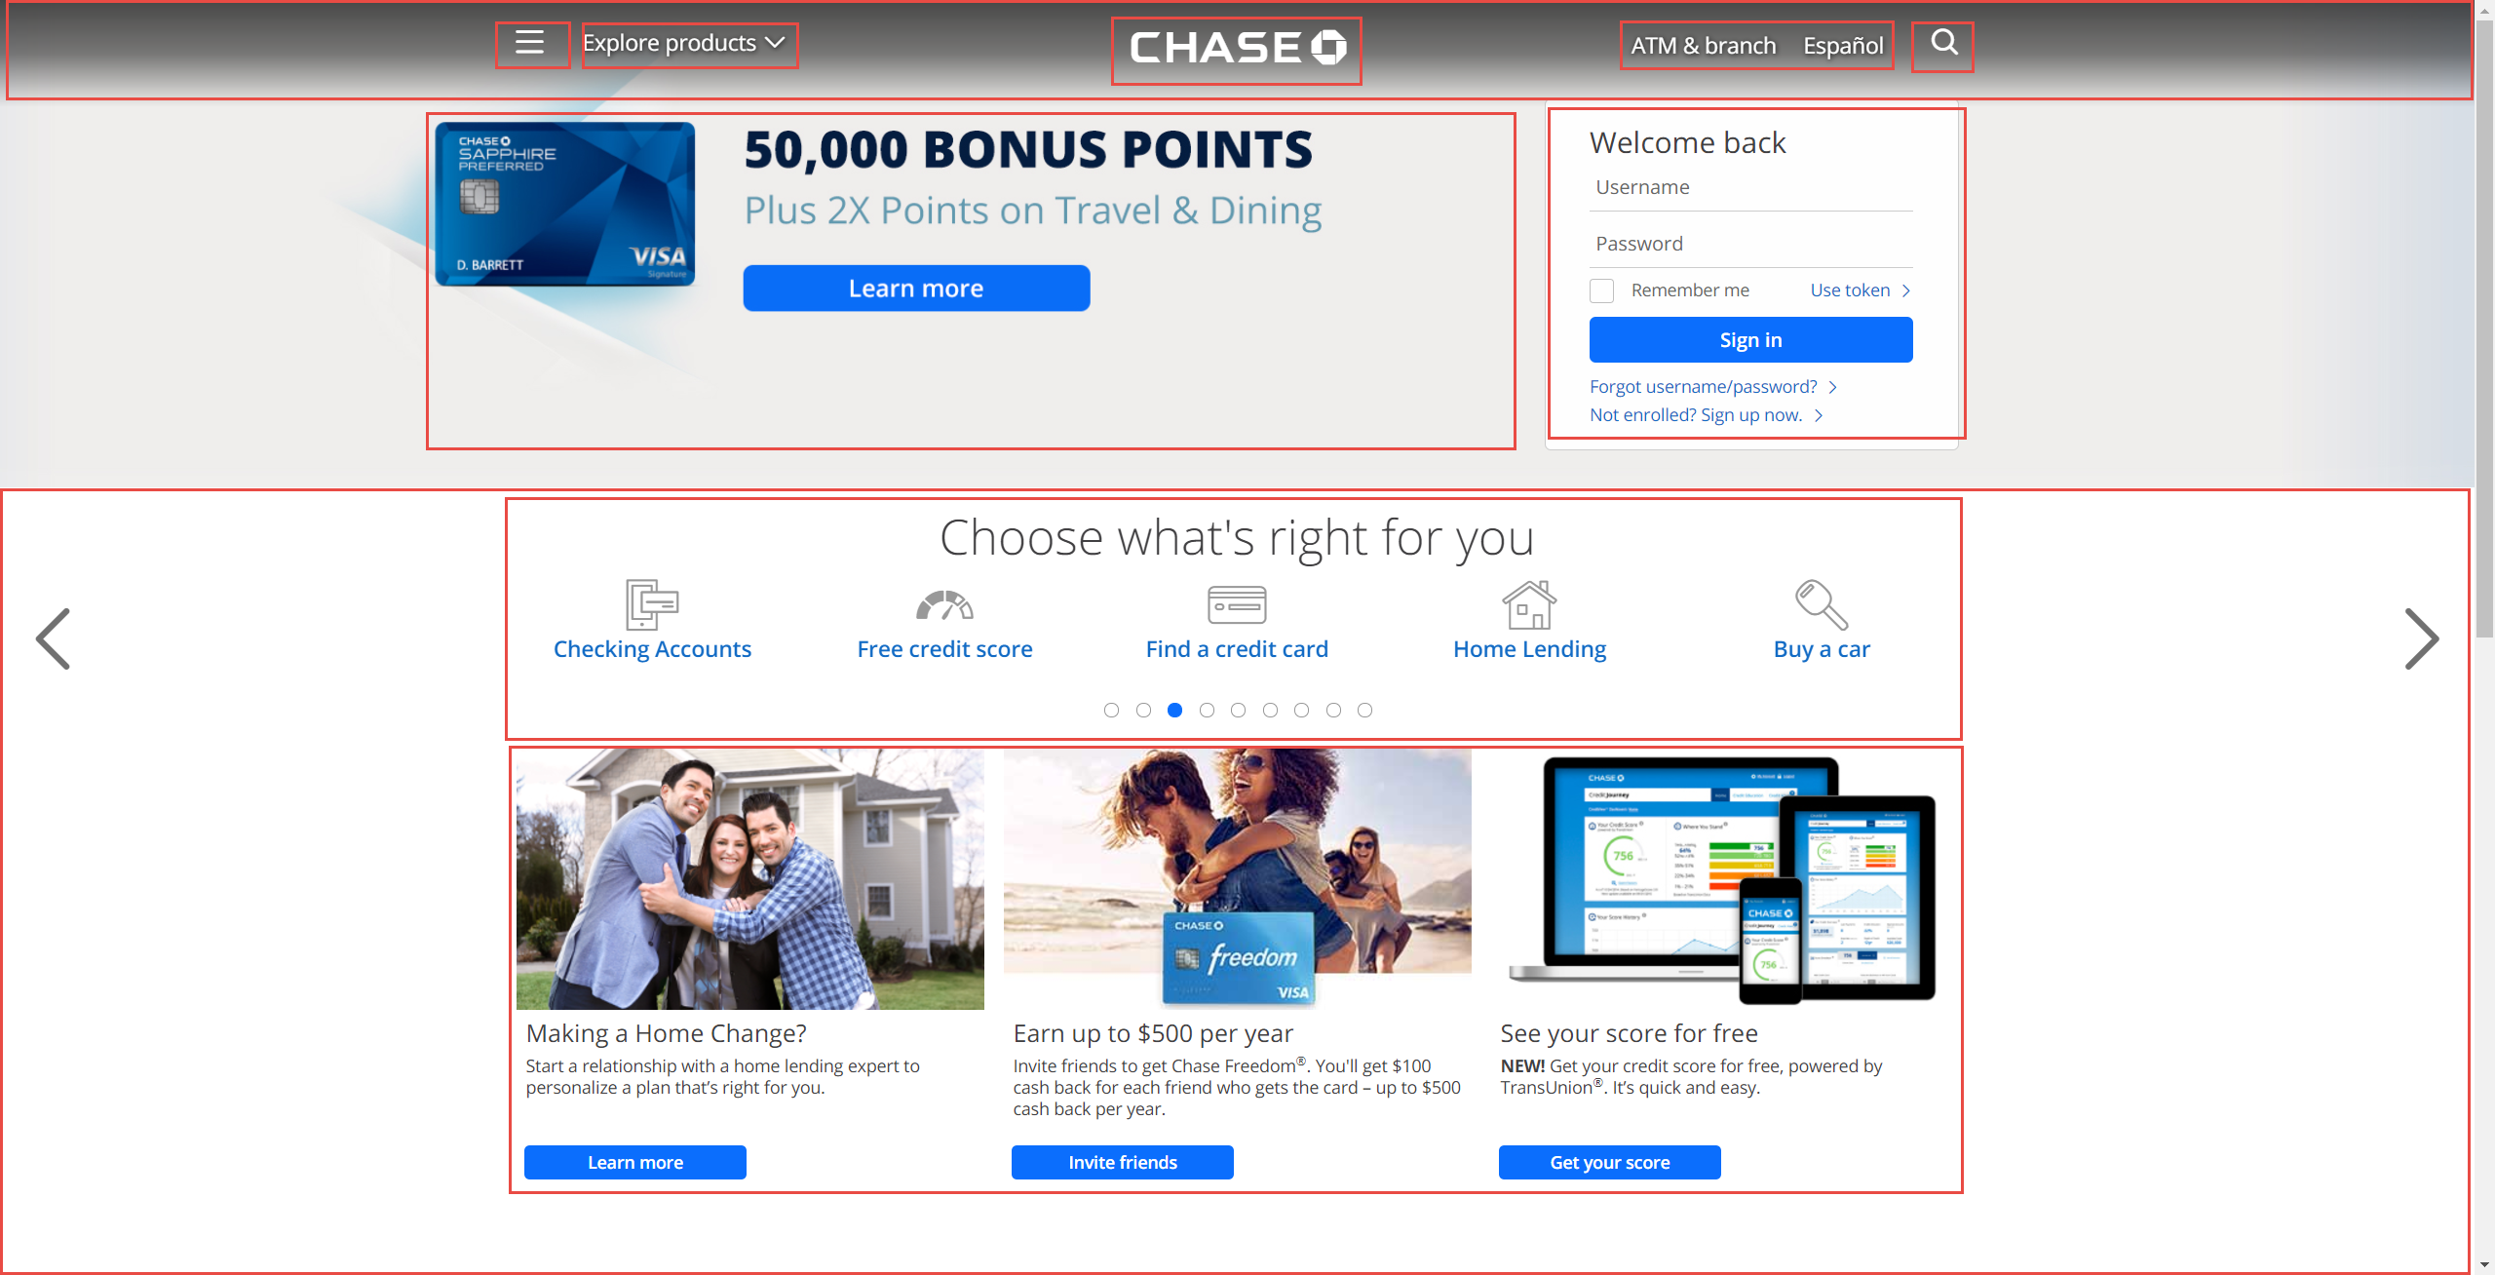

Slide 19
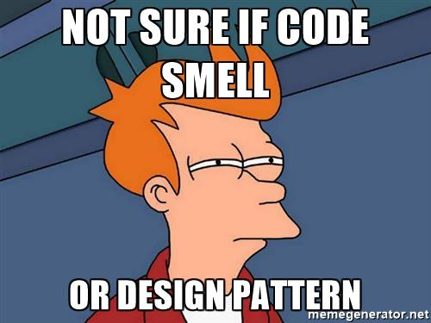
Code Flow and Smells

Slide 20
Structuring a method
Happy Path always at the bottom of the method
Don’t want to scan for “what happens when all goes well” and find it in the middle of a method
Use return’s instead of nested if => else

Slide 21
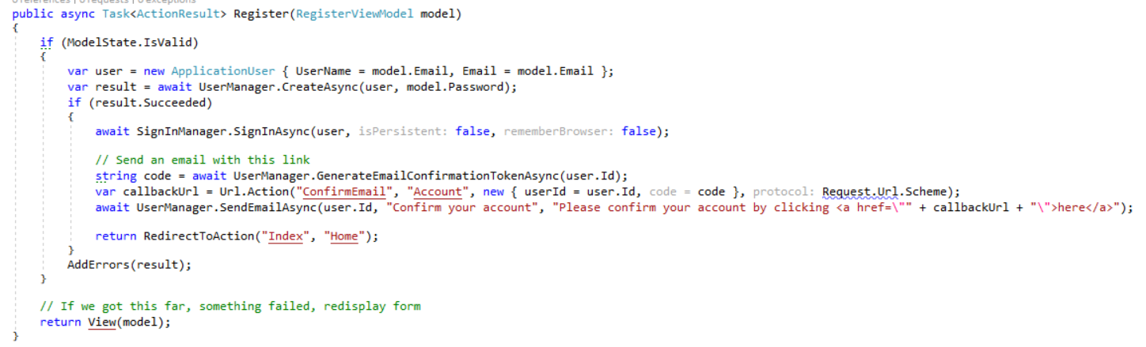
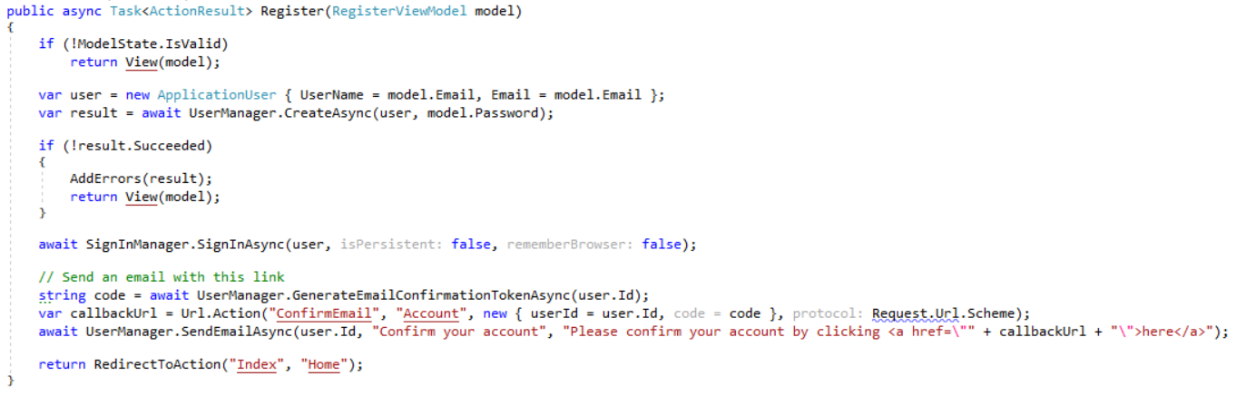
MVC 5 Template Code:
Refactored with Happy Path at the bottom:

Slide 22
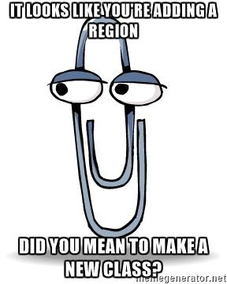
Code smells
Methods > 30 lines
Classes > 200 lines
Anytime you scroll down, up, down to find what you’re looking for
Regions
You probably should’ve added a new class or method instead

Slide 23
Validation

Slide 24
Validation – What’s wrong with OOB Options
Data Annotations
OOB annotations only work well for simple scenarios
Hard to make custom ones
Hard to unit test
Separate annotations for each property
Heavy, lots of classes
Can get “tall”
SRP violated
Model + Validation combined into one class
Writing own Custom Validation classes
Lose client-side hooks Data Annotations provides
Validation in Controller Action
Hard to maintain and test
Bloated Controllers

Slide 25

Solution: Use FluentValidation
Fluent interface
Business rules are easy to maintain and read
Easy to show a stakeholder
Easy to test
Integrates with ModelState.IsValid
Same Client-Side validation as Data Annotations
2.6M downloads
https://github.com/JeremySkinner/FluentValidation

Slide 26
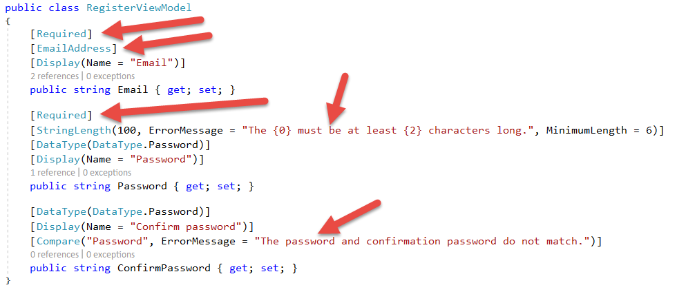
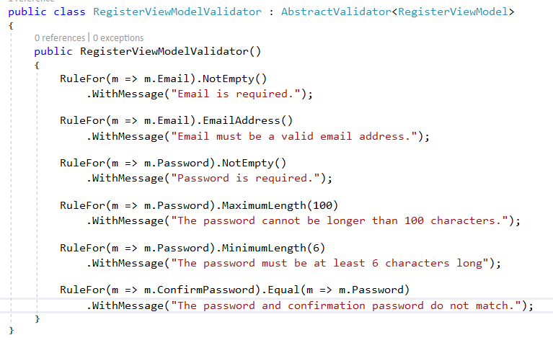
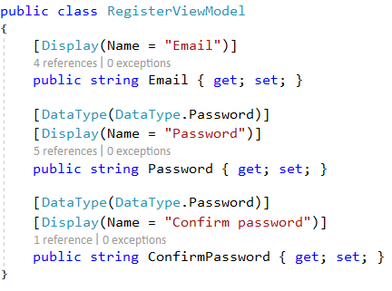
MVC 5 Template Code:
Refactored with Fluent Validation:

Slide 27
ORM’s

Slide 28

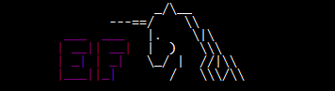
Don’t use raw ADO - Use an ORM
Entity Framework – Full ORM
Pros
Developer Productivity
Compile-time safety with LINQ Queries
Extremely quick to add new CRUD operations
Built in Unit of Work
Migration support
Cons
Less performant
Less control over the queries generated
Heavier
Dapper – Micro ORM
Pros
Performance near ADO
More control over the queries
Extremely simple to setup
Stack Overflow beta tests
Cons
SQL strings = Big column name refactorings are harder
Less features than EF

Slide 29
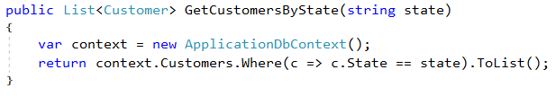
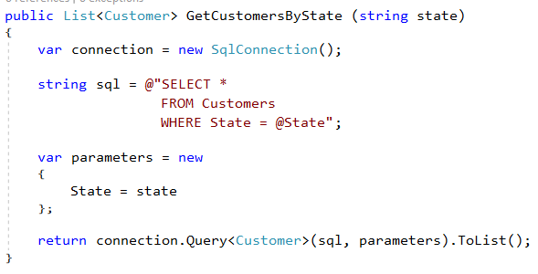
ORM usage comparison
Entity Framework:
Dapper:

Slide 30
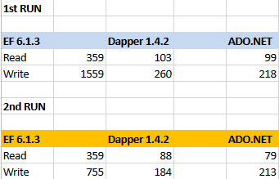
Other ORM things
Both manage connection lifetimes
Both give you SQL Injection protection
We use both depending on the job
Common for us to start with EF and supplement with Dapper
EF for Developer Productivity
Dapper for hot paths
Dapper for queries that are tough to write in LINQ
DON’T WRITE YOUR OWN ORM
Performance:

Slide 31
Dependency Injection

Slide 32
Dependency Injection and IoC containers
DI/IoC helps you loosely couple your “large” apps
Lets you unit test anything if done correctly
I use SimpleInjector
Performance
~80x faster than Ninject, ~20x faster than Structure Map, ~30x faster than Autofac
Crazy good docs
Verify step has saved me more than once

Slide 33
Common DI Pitfalls
“New Is Glue”
“Static Cling”
DateTime.Now (and variants)
Instead inject in IClock or have method take in DateTime? and default to Now
HttpContext.Current.User.Identity
.GetUserId()
.Name
Instead, inject in your user (per request!)
ConfigurationManager
Instead, inject a POCO Settings class

Slide 34
Unit Testing

Slide 35
Unit Testing with xUnit
You should be writing automated tests
Exposes holes in your architecture
Can be faster in short term than manual testing
Proven to be faster long-term
Make changes quickly and confidently because have a regression test suite
Use xUnit or NUnit
Just not MSTest which is wayyy more verbose and has less features
xUnit used by ASP.NET team
We used to use NUnit and switched to xUnit
NUnit more boilerplate

Slide 36
Problem: OOB Assertion Libraries Annoy Me
Assert.Equal(value, value)
Hard to remember that it’s Assert.Equal(expected, actual)
Can lead to funky looking assertion failures if you flip them
No “Because” string in xUnit’s assertions

Slide 37
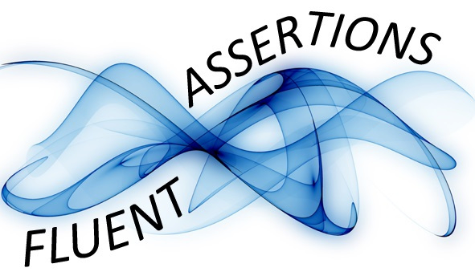
Solution: Use FluentAssertions for assertions
Adds a Should() extension method to object
result.Should().Be(0);
Easier to read than Assert.Equal(0, result);
Should().Be() is primary use, but other methods exist
someBool.Should().BeTrue() or BeFalse()
someString.Should().BeNull() or NotBeNull()
Because string to explain why
can12YearOldDriveResult.Should().BeFalse(“because you must be 16 years old to drive.”)
4.3M downloads

Slide 38
DevOps

Slide 39
What is DevOps
“DevOps is the union of people, process, and products to enable continuous delivery of value to our end users.”
- Donovan Brown

Slide 40
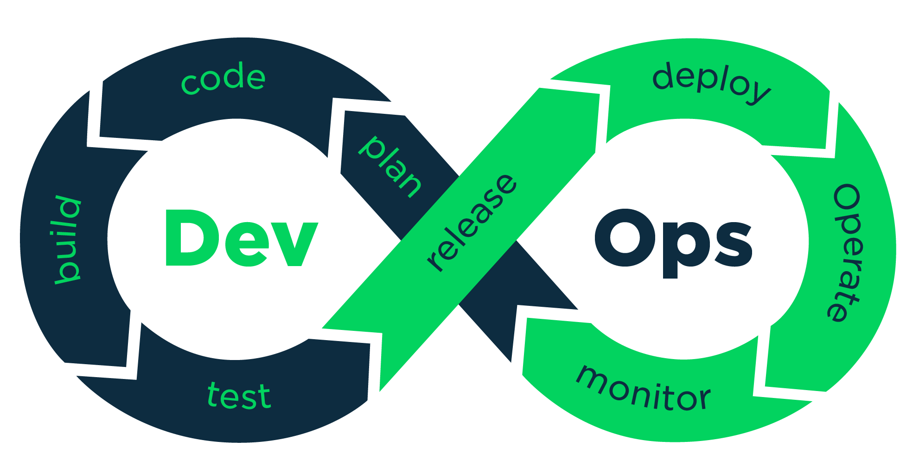
DevOps Pipeline

Slide 41
Continuous Integration and Deployment
Continuous Integration
Automated builds running on an independent build server
Automatically running automated tests
Creates an output
Continuous Deployment
Takes the output from the build server and deploys it
Go through different environments
Automated configuration of VM, IIS, folder permissions, etc.
These two together will be transformational for you and your company

Slide 42
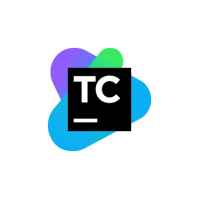
Continuous Integration with TeamCity
Free for up to 20 build configs (projects)
NuGet Restores
MSBuild
Don’t need to install VS on your build server
Run automated tests
Produces an output
Zips up and sends to Octopus Deploy

Slide 43

Continuous Deployment with Octopus Deploy
Lets you promote your package through different environments
Controls all web.config settings, scoped to each environment/role
Auto-creates IIS Site and App Pool for you
Deploys and rollbacks are click of a button
Lets you run any scripts you want to as part of your deployment
Easy to install and easy to use
Professional – 20 users, 20 projects, 20 machines $700 one time and 50% maintenance per year
Full Audit Trail
Who/What/When changed
My single favorite piece of software – ever

Slide 44
TeamCity + Octopus Deploy enables...
Consistency
Machine repeats the same steps over and over again
Consistency promotes Confidence
Passes build
Passes automated tests
Configuration is correct
Let’s deploy it to Prod!
Confidence enables agility
Mid-day publishes are no big deal
For a single app, our record is 24 publishes to Prod in 1 day with 2 developers

Slide 45
Feature Toggles
No long lived branches
Commit to master instead!
Behind an if statement
Commit to cleaning up after it’s live
Clearly separate out your Feature Toggles to make it obvious what Feature Toggles exist
Simplest way to toggle on and off: let Octopus Deploy handle toggling your feature on or off per Environment.

Slide 46
<Something about Microservices />
Microservices add operational complexity
Health Checks
Is it running? Are the dependencies ok?
Load Balancing
Service Discovery (via Consul or something simple like config files with primary/backup)
Microservices add development complexity
HTTP call (most likely) instead of a method call
If calling from C#, likely want a client library wrapper around HttpClient sending JSON
Dev environment needs multiple projects running
Benefits
Iterate on microservices separate from other app (SRP)
Reuse
Scale independently
We use in moderation
Emails, Texts, CPU/Latency Intensive ops (Order Floods, Pull Credit), Uploads, Retrieving Files, etc.
I swear this is in moderation
I’ve found these often live at unique Bounded Contexts or Cross-Cutting concerns across multiple apps.
You are not Google/Facebook/Netflix/Amazon
Unless you are… in which case… my bad

Slide 47
Real benefits of these practices
1 web app went from deploying to Prod 20x a year to deploying to Prod over 500x a year.
Faster delivery of value to users.

Slide 48
Summary
Feature Folders > MVC Folders
View Model All The Things
SRP for UI with Components
Happy Path at the Bottom of a Method
FluentValidation over Data Annotations/Custom
Use an ORM
Avoid new, Statics, HttpContext, ConfigurationManager for testing
Automate your Build and Release pipeline
Resist Microservices until there’s a reason not to

Slide 50
Closing
Hope you got at least one idea out of this
Remember – point is to deliver value to your end users as quickly and reliably as possible and allowing that trend to continue.
Don’t get caught up in what library you’re using
If you use NUnit instead of xUnit and have no reason to switch – who cares?
Important thing is you’re doing automated testing.

Slide 51
Questions?

